Slide 1

SILENT ROOM
Your comfort zone. Come in!

Slide 2
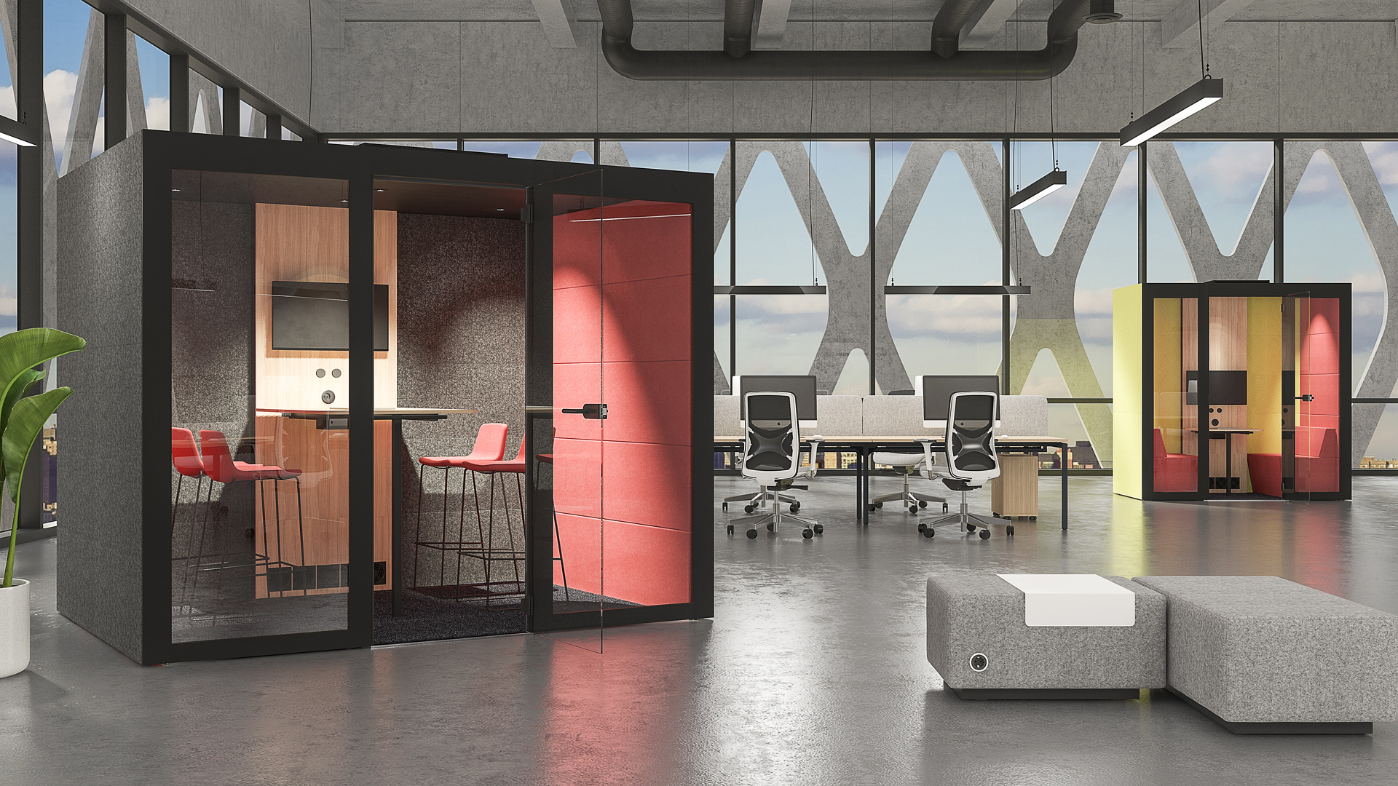
Notes:
Open plan offices mean more space, more light, more freedom, and... more noise in the work environment. Every day, employees face increasing challenges in finding a quiet place to hold meetings, have phone conversations or simply focus on individual work. “A room within a room” is a simple way to keep noise distractions at bay and to ensure employee productivity.

Slide 3
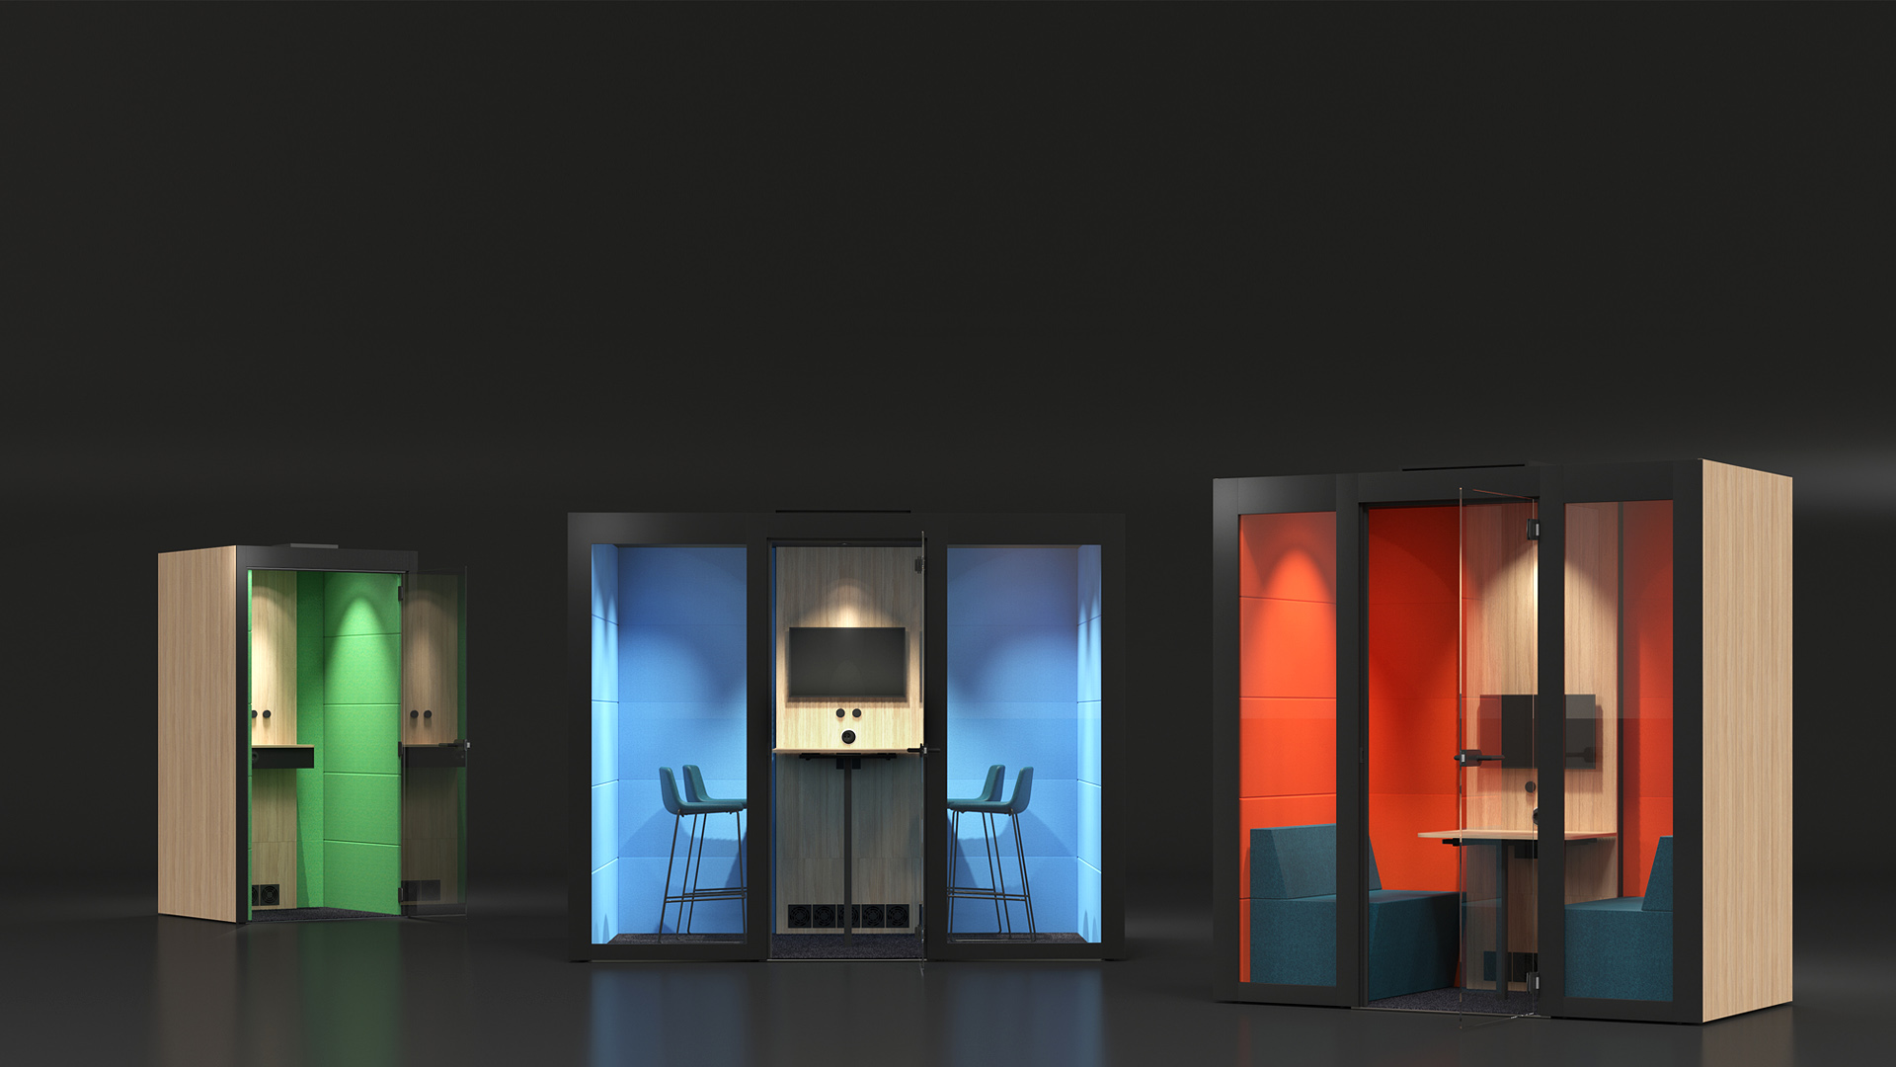
SILENT ROOM
The oasis of silence in a middle of a modern office

Slide 4
ACOUSTIC ABSORPTION AND INSULATION

Slide 5
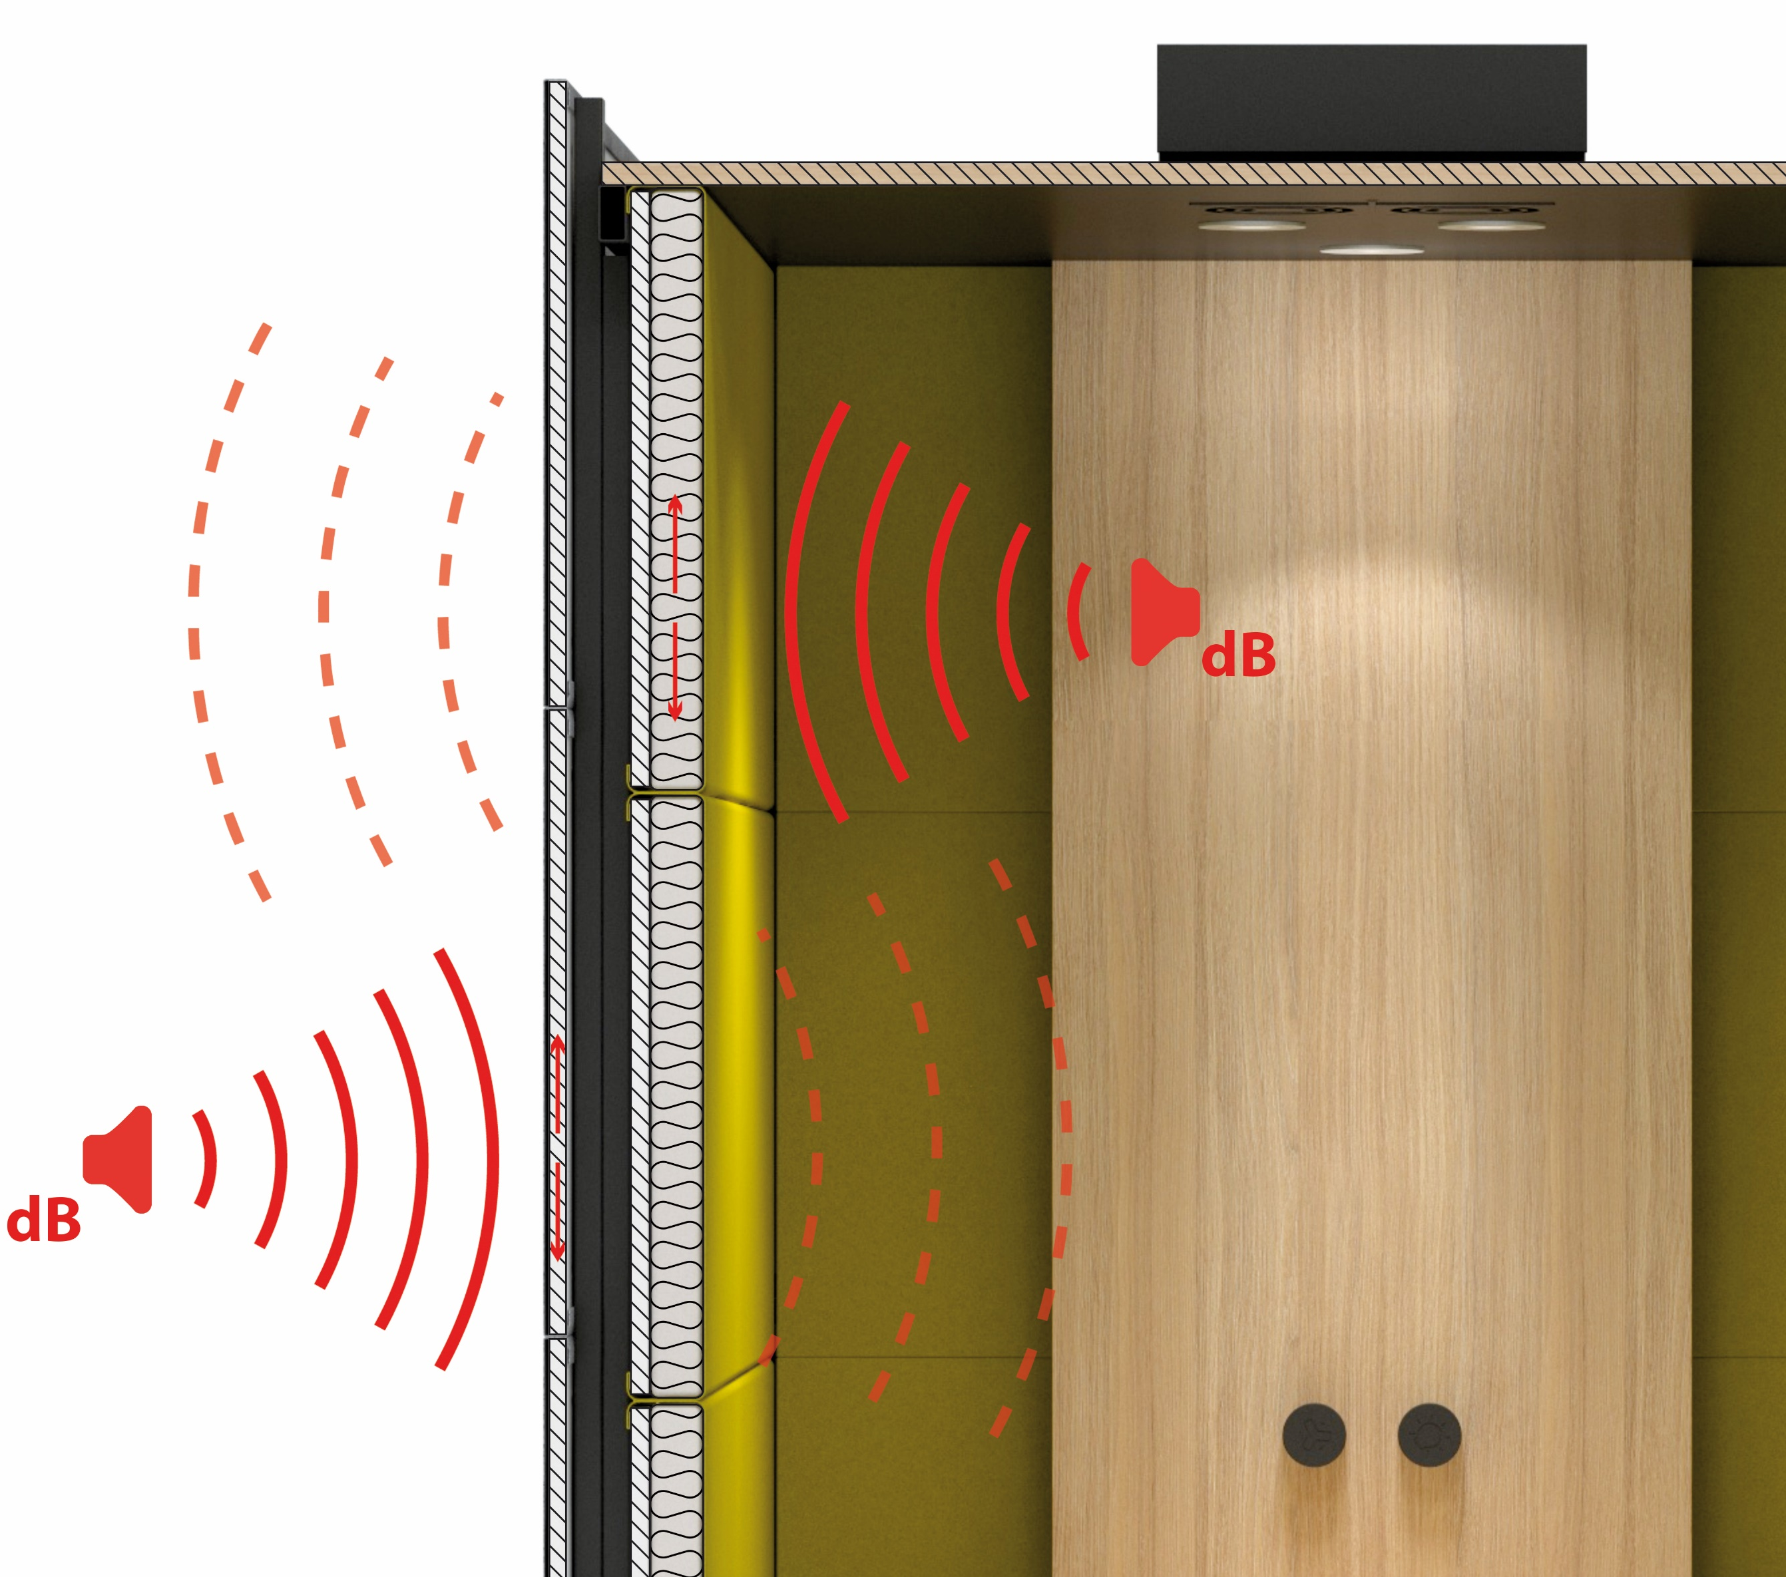
High class acoustic material and multilayered texture
Notes:
Multilayered SILENT ROOM wall structure, hermetic door and ceiling ensure sound insolation. The inner layer of the panels is made from high-class acoustic material that eliminates echo and has excellent sound absorption properties.

Slide 6
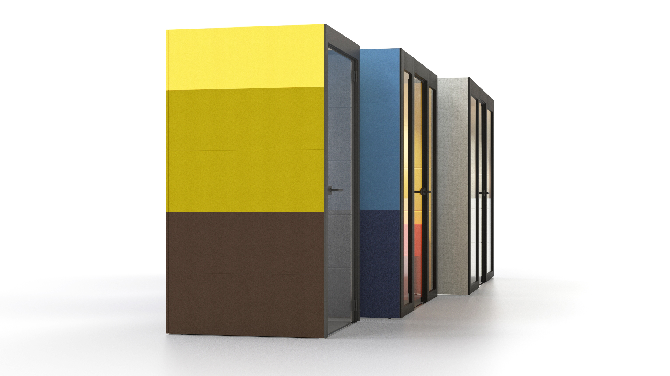

Acoustic comfort
Notes:
The upholstered exterior panels absorb noise and have a positive effect on the general acoustics of the office space.

Slide 7
ERGONOMICS AND COMFORT

Slide 8
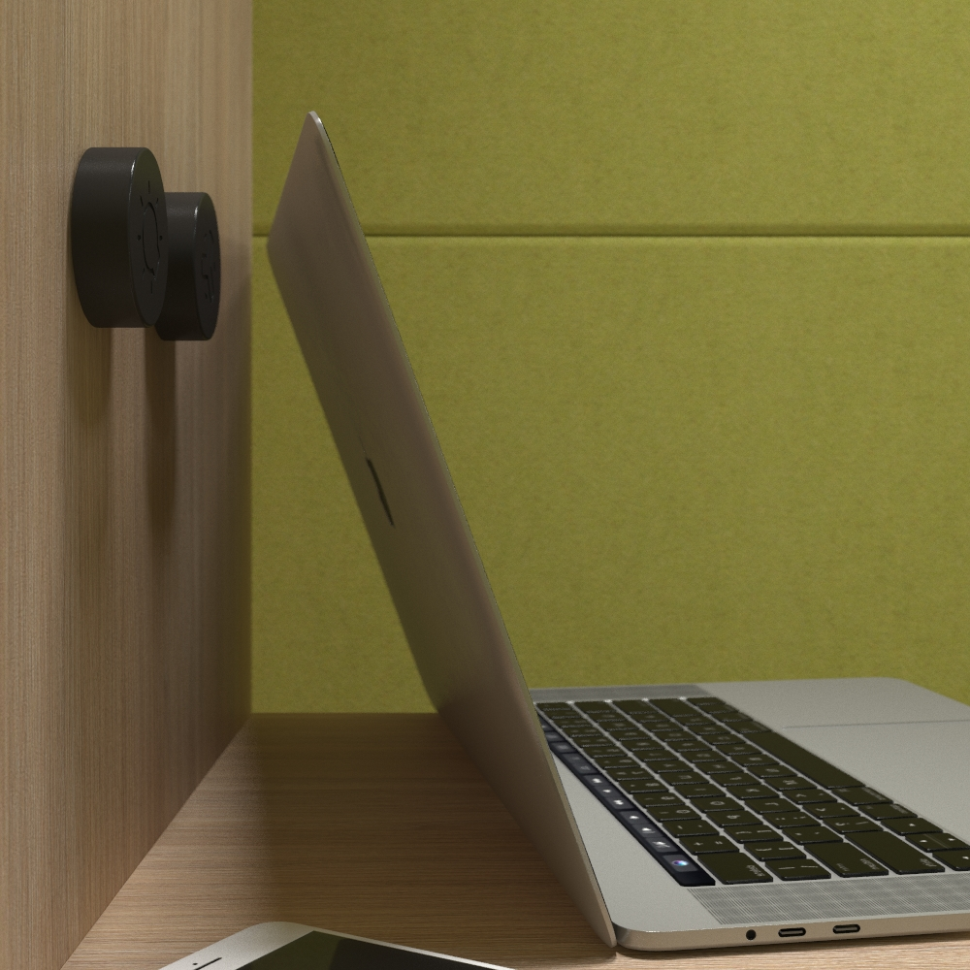
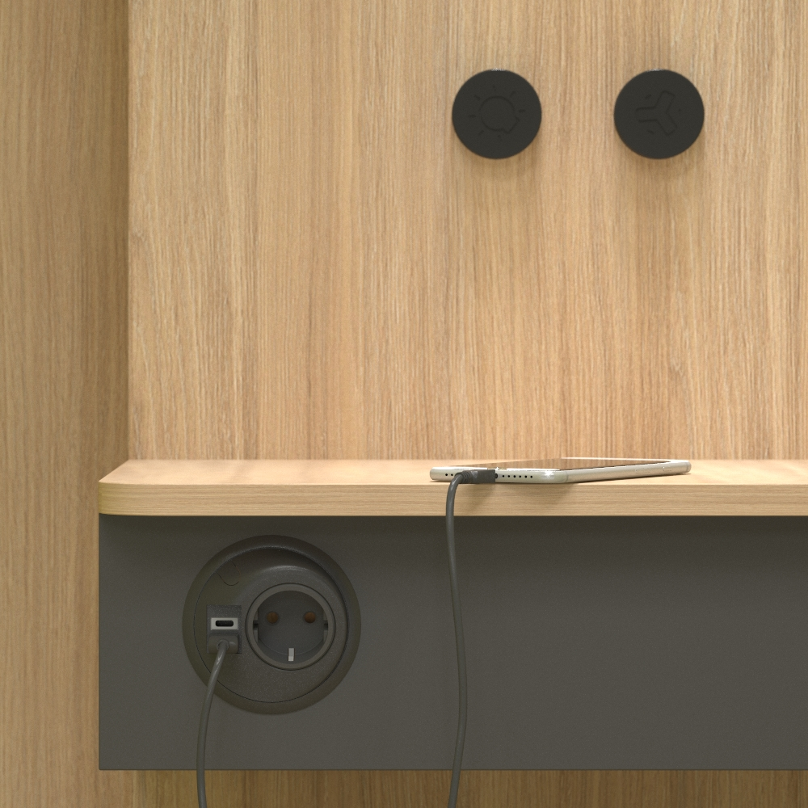
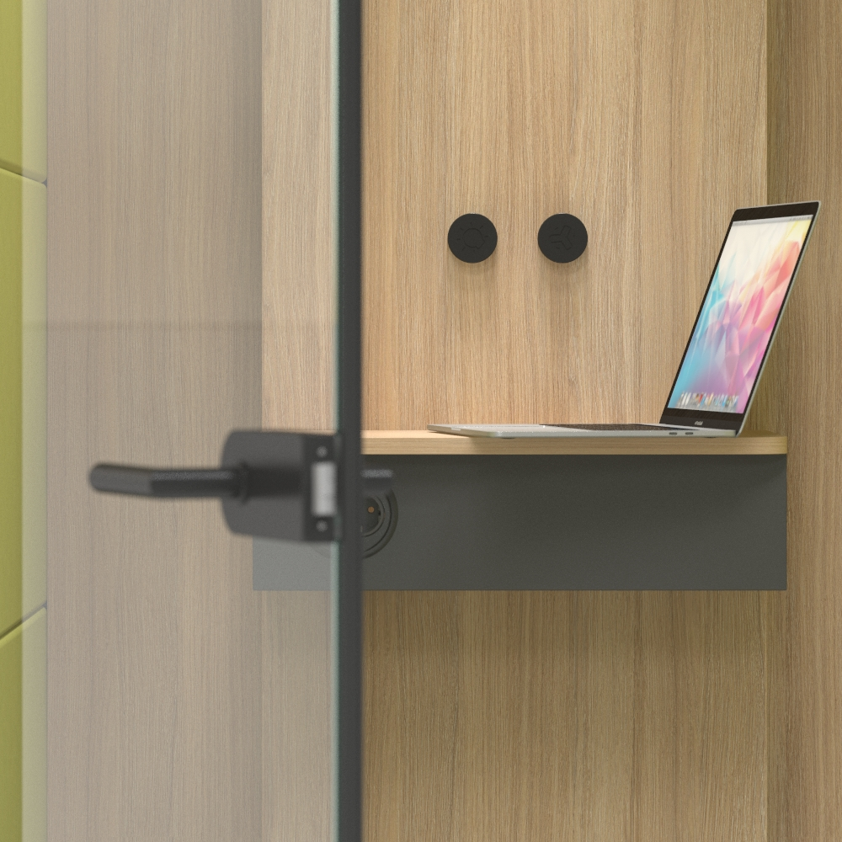
Spacious interior and privacy
Notes:
Measuring 1,074 mm in width, 938 in depth and 2,150 in height, the interior of the SILENT ROOM S ensures the user’s comfort and freedom of movement. The room is equipped with 110-230 VAC as well as USB Type A and C connectors so it can easily be adapted to a variety of activities including long phone conversation or video conferences.

Slide 9
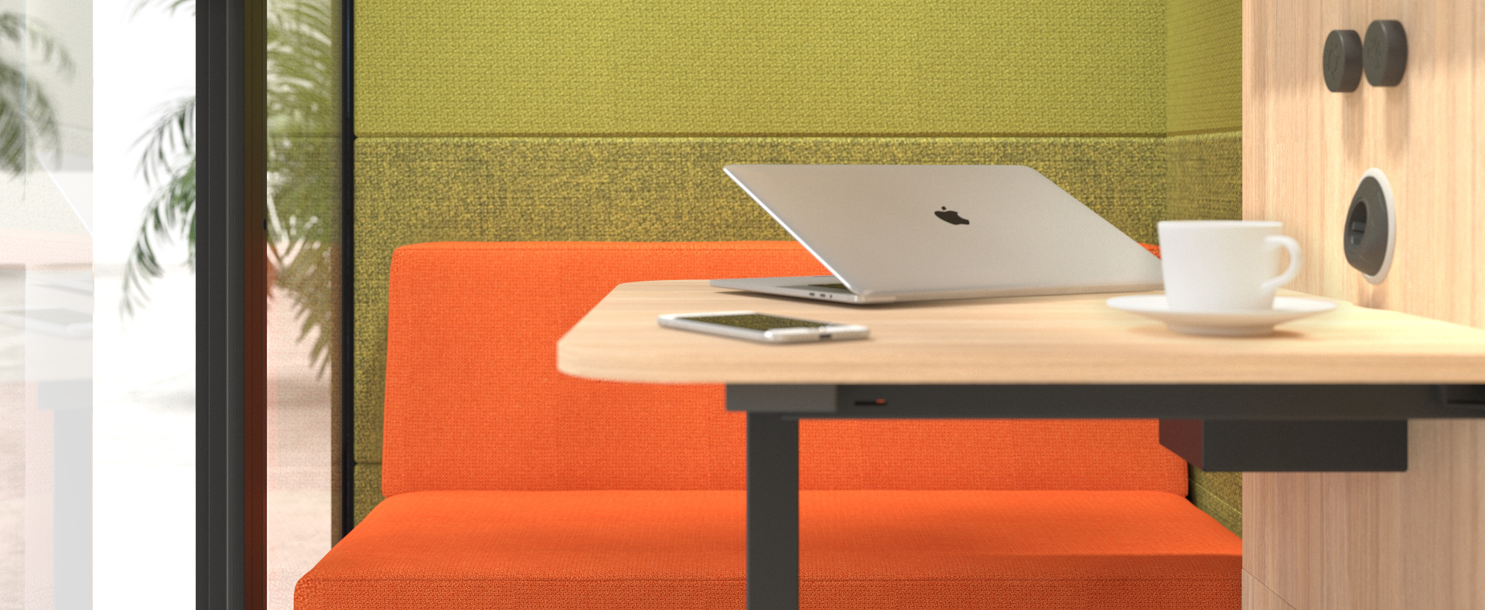
Comfortable environment and privacy
Notes:
SILENT ROOM M can be combined with lounge seating which features eye-catching design and offers exceptional comfort, giving a more homely feel to this acoustic furniture. It will turn even the longest face-to-face meetings into an enjoyable and relaxing experience.

Slide 10
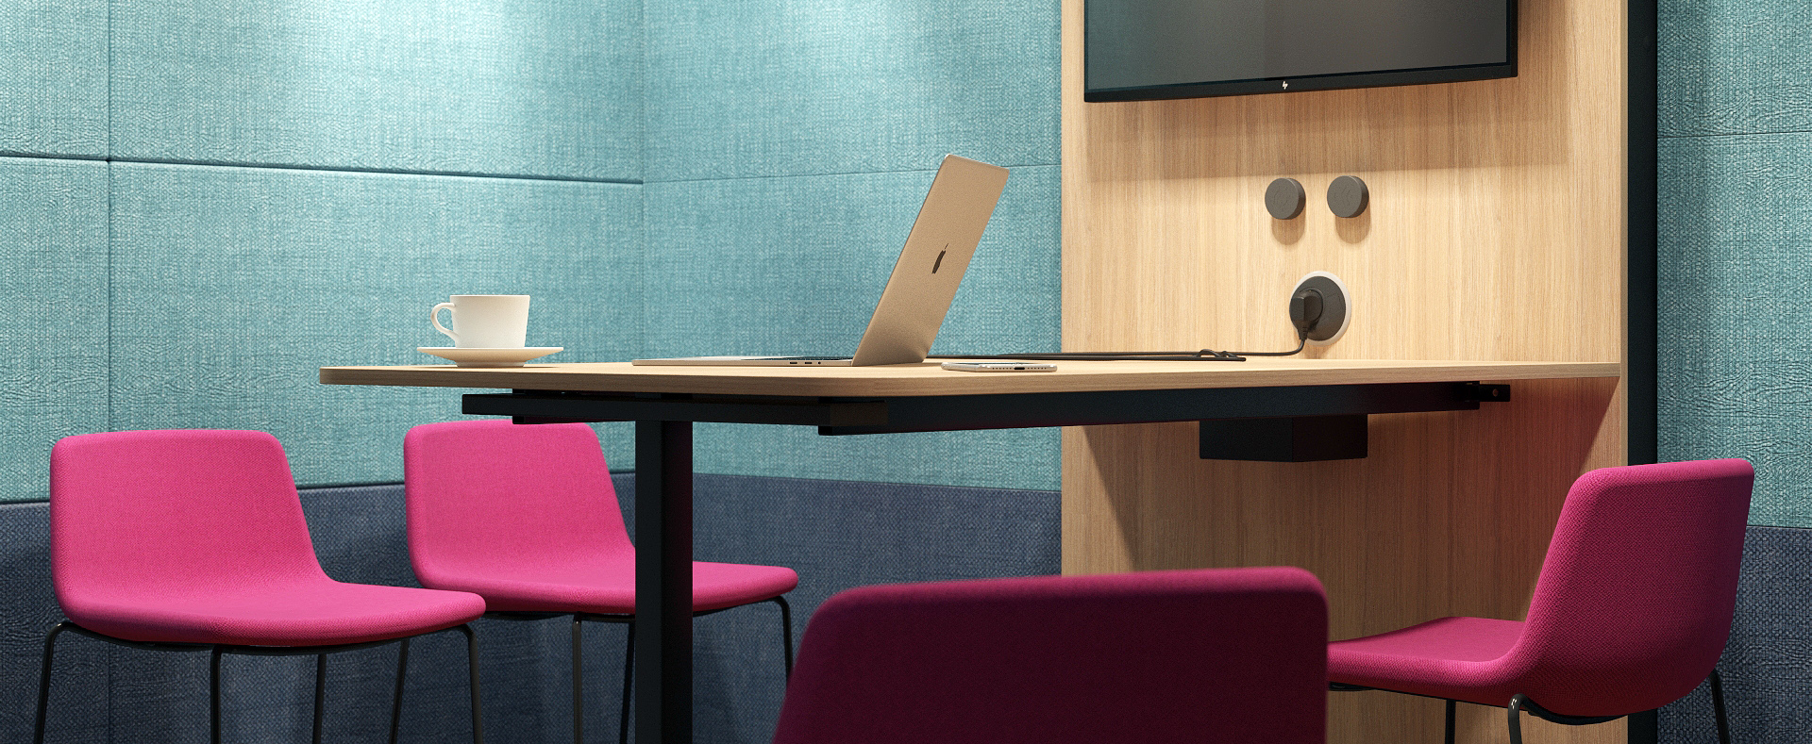
Engaging and
casual space
Notes:
SILENT ROOM L has an interior capacity of as many as 10 cubic meters. It can easily accommodate four people around the large bar-height table with the possibility to engage even more participants thanks to the latest technology.

Slide 11
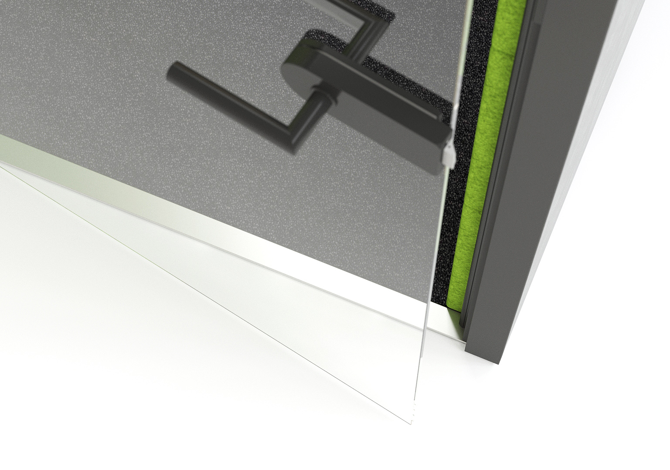
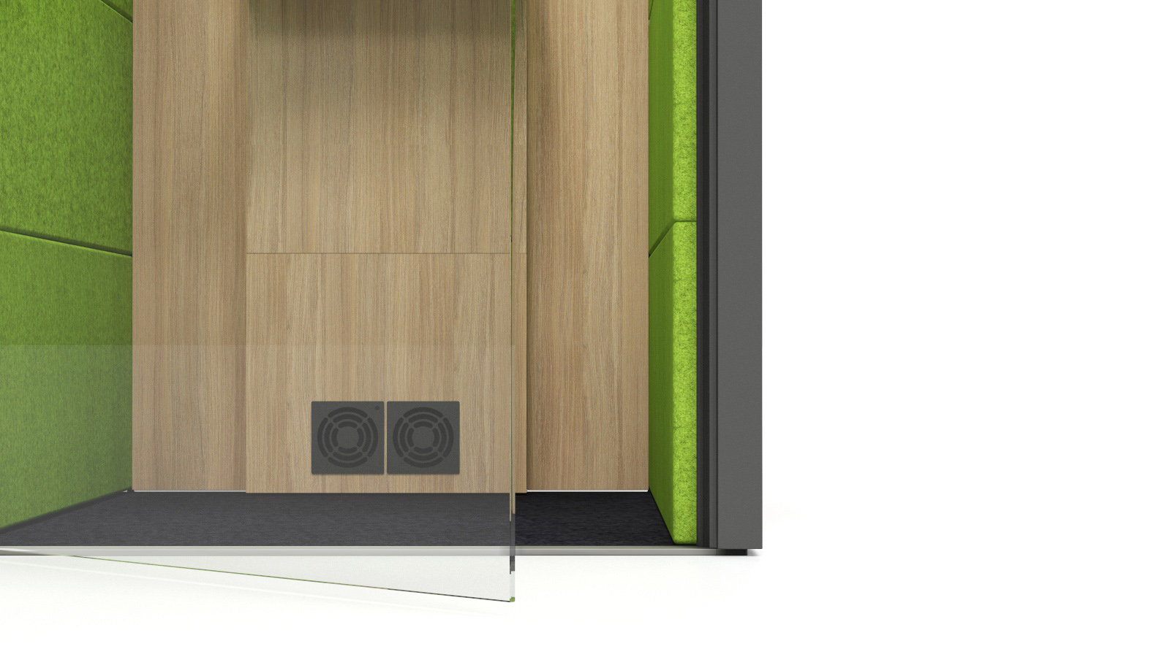
Convenient entry
Notes:
Getting in and out of the SILENT ROOM is easy: a low doorstep and same level floor ensures that no caution is needed while stepping inside.

Slide 12
VENTILATION AND LIGHTING

Slide 13
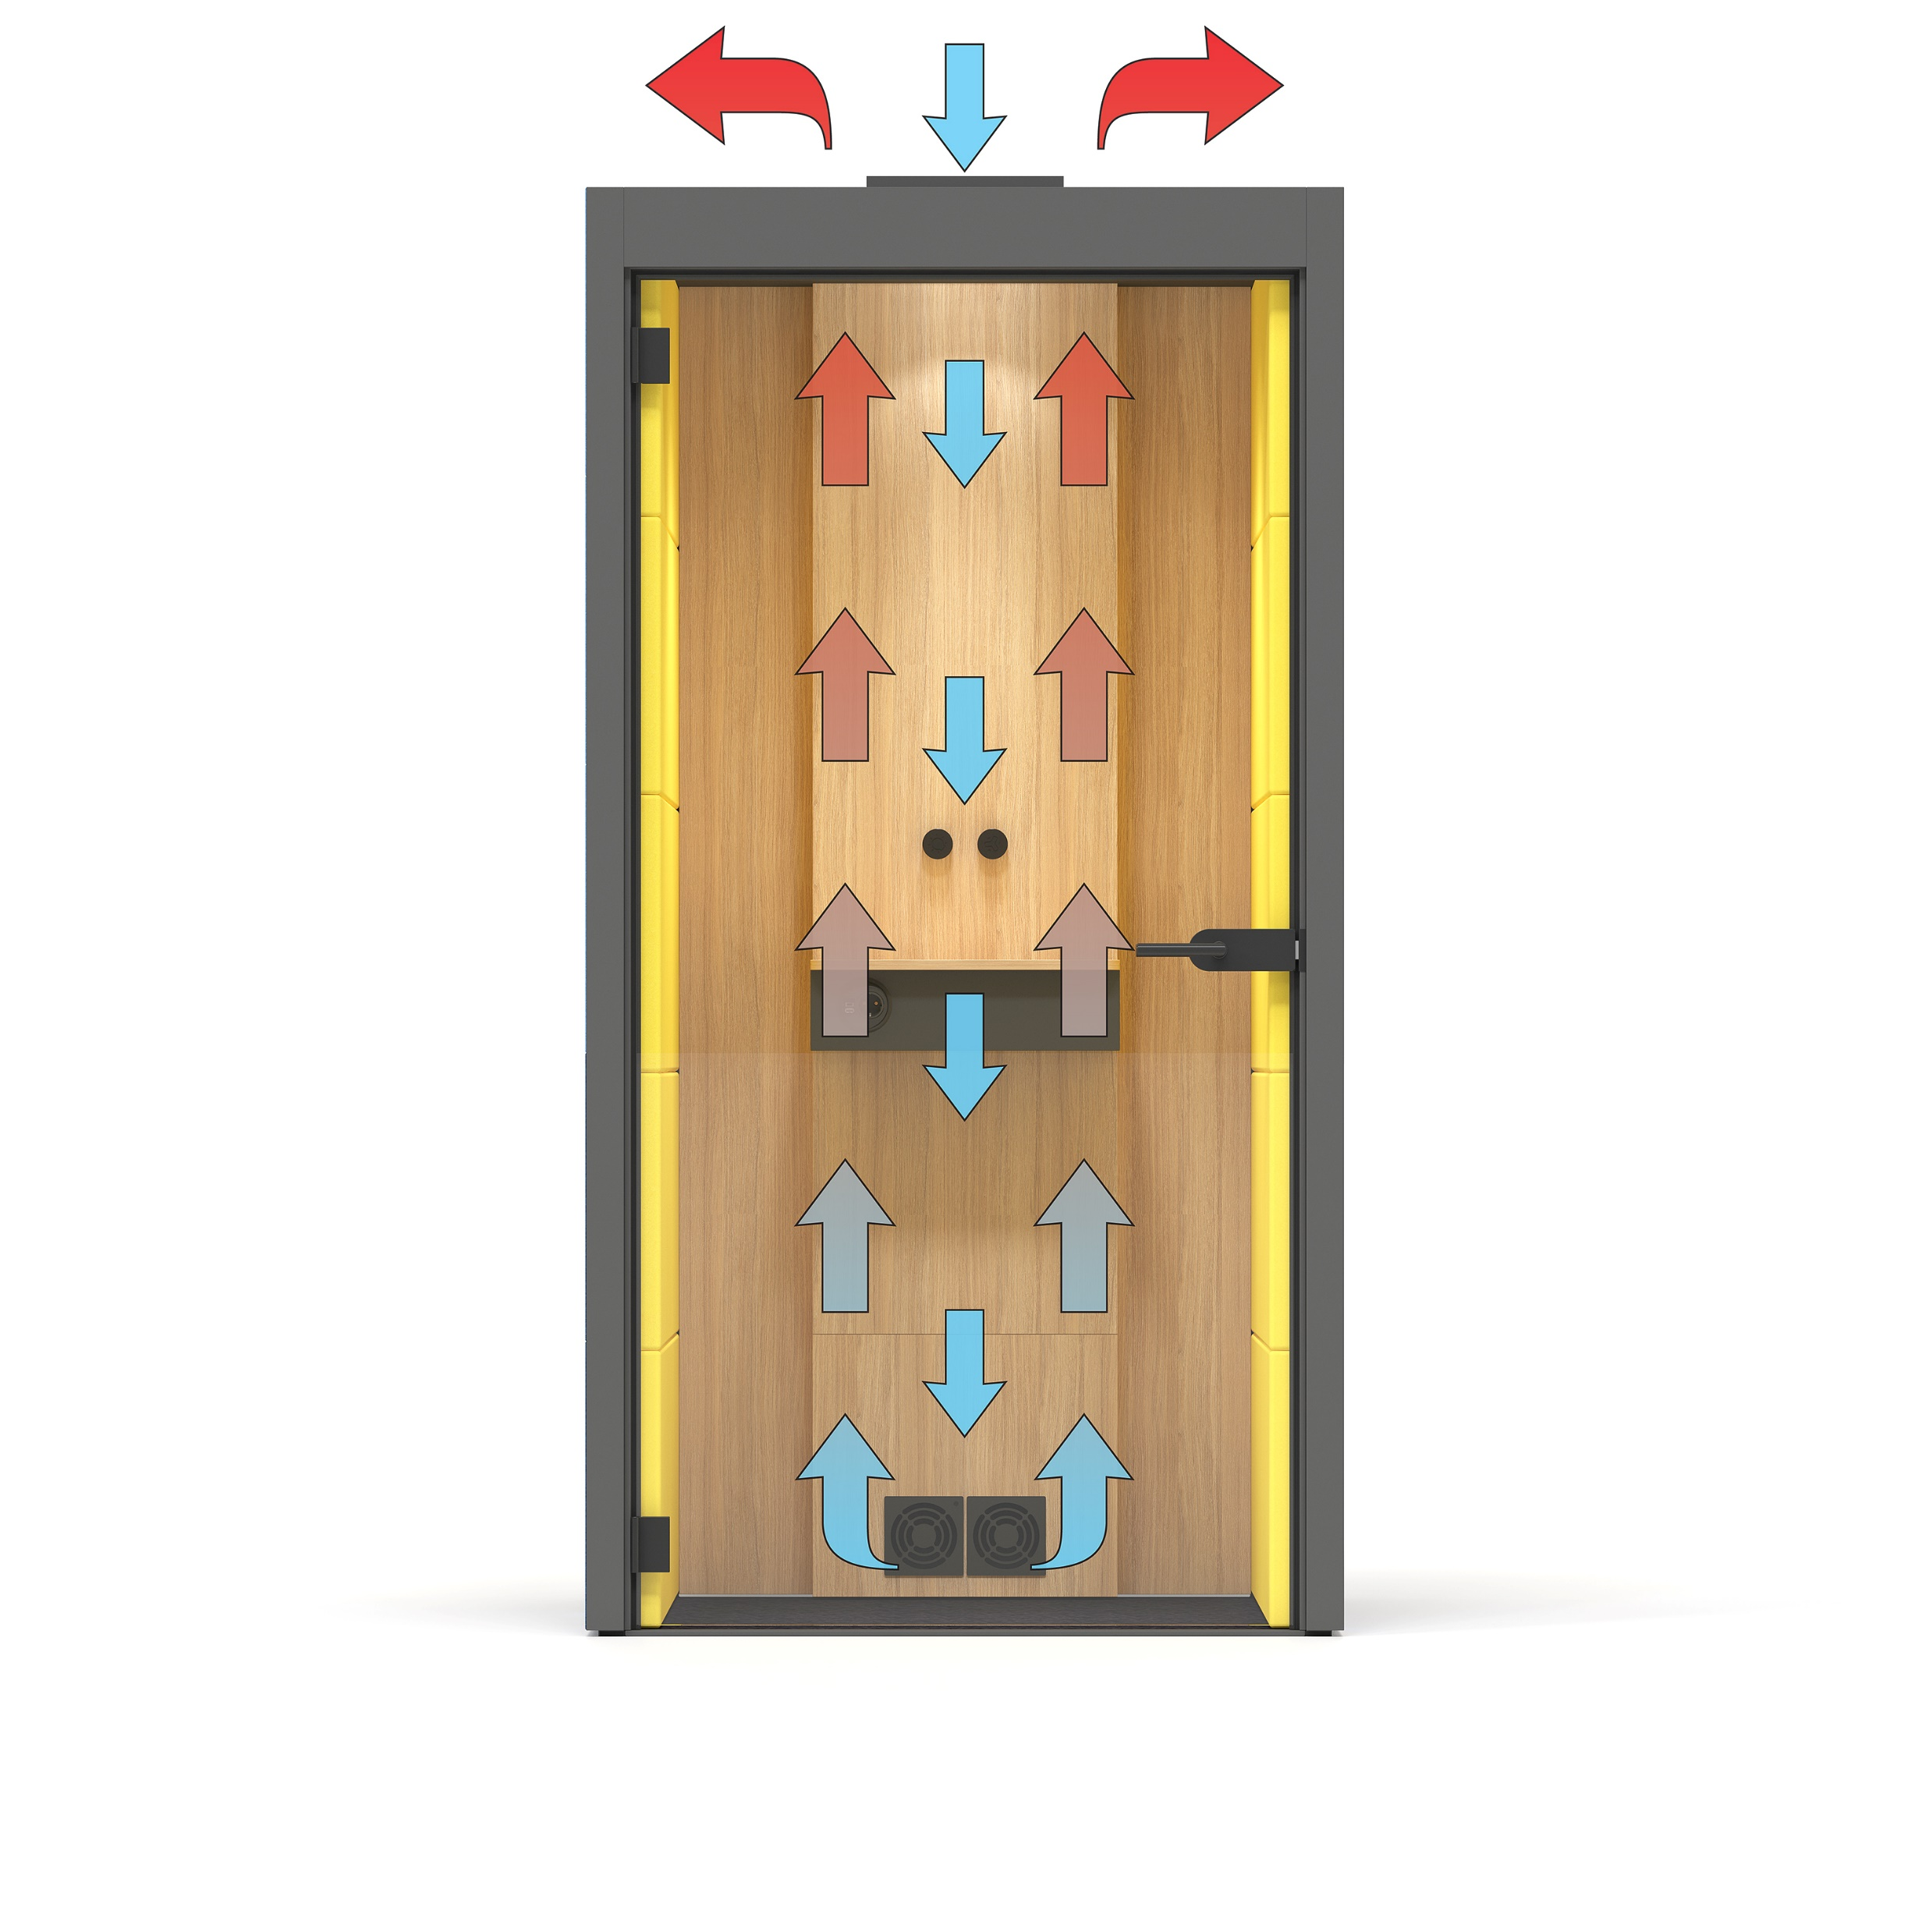
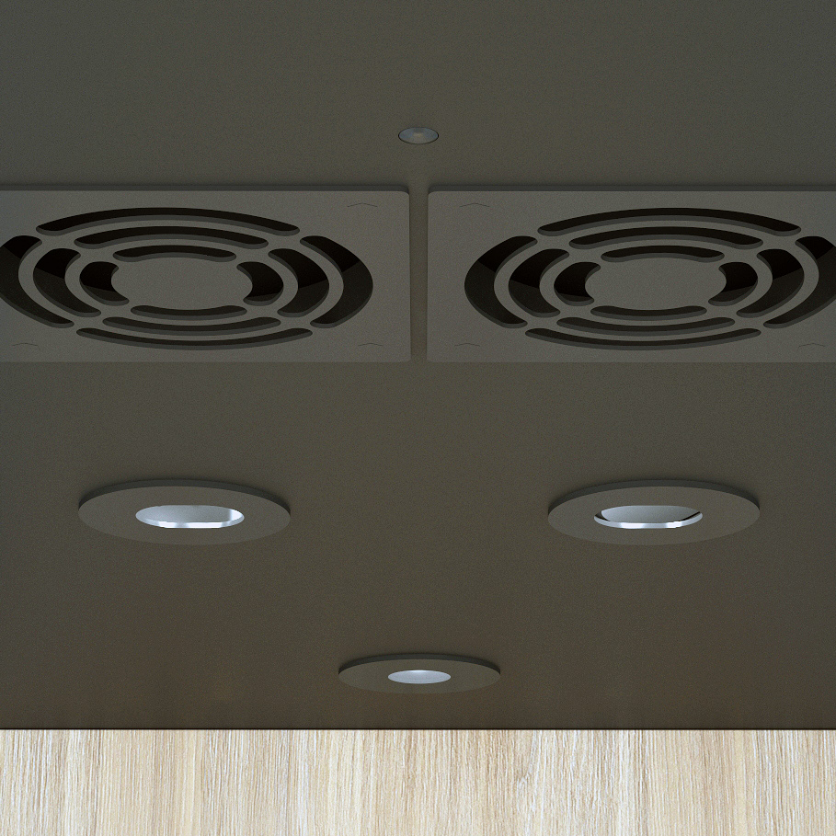

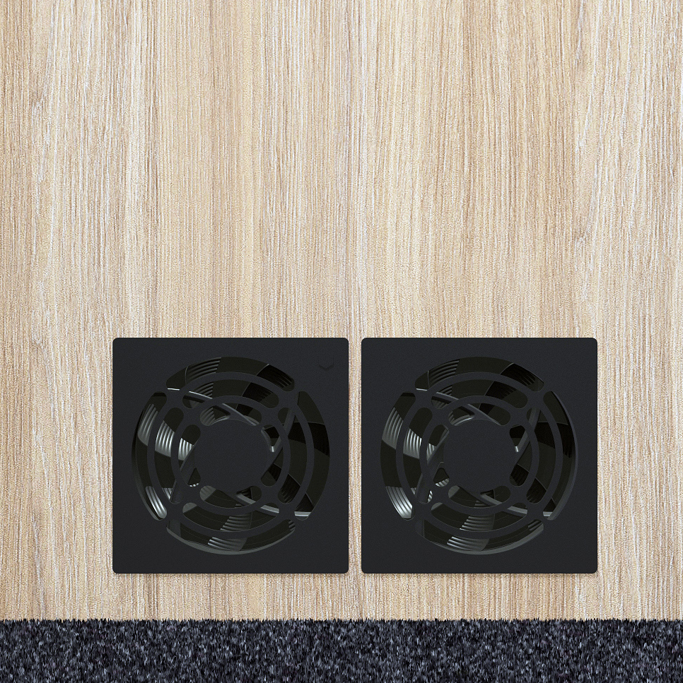
Efficient air ventilation
200 m3/h
SILENT ROOM S
Air exhaust
400 m3/h
SILENT ROOM M
500 m3/h
SILENT ROOM L
Air intake
Notes:
SILENT ROOM is equipped with an efficient forced air ventilation system. Silent and powerful air ventilators ensure a proper air flow rate and provide an ultimate sense of comfort even during extended use. SILENT ROOM S is equipped with 4 ventilators, SILENT ROOM M features 8 ventilators, whereas SILENT ROOM L has as many as 10 ventilators with a total capacity of 200, 400 and 500 m3/h, respectively.

Slide 14
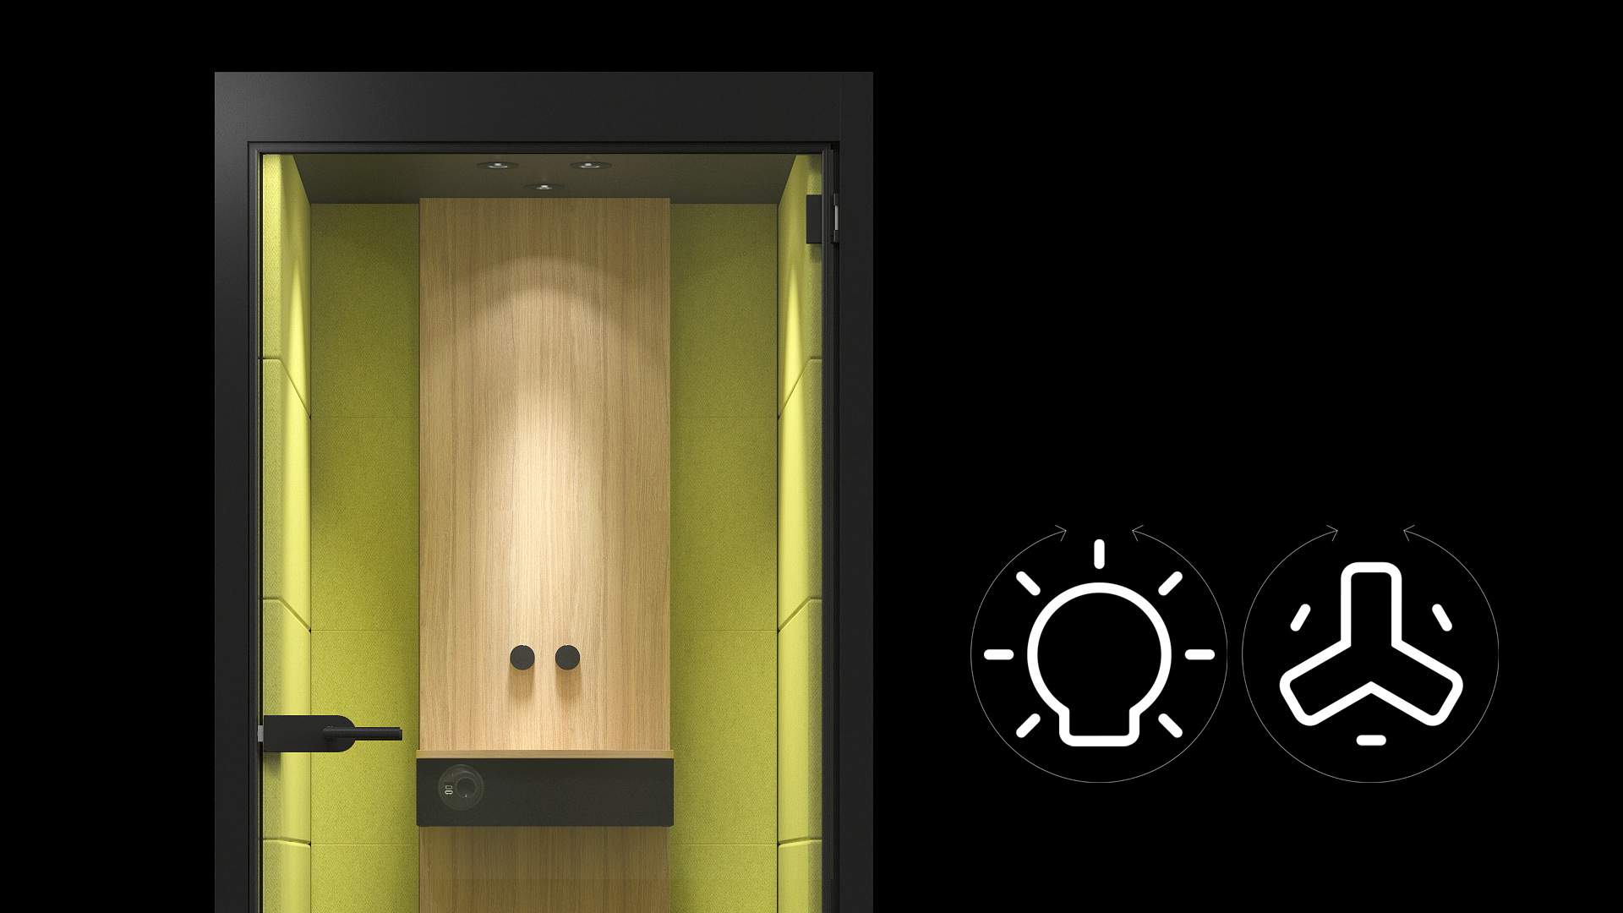
Warm LED lighting
Notes:
The interior lighting consists of a set of ceiling-mounted warm LED lights. Some of the lights are directed sideways, casting warm and cosy light on upholstered surfaces, whereas the rest ones are directed downward ensuring efficient illumination of the working surface. The intensity of the lighting and ventilation can be easily adjusted by turning two minimalist switches.

Slide 15
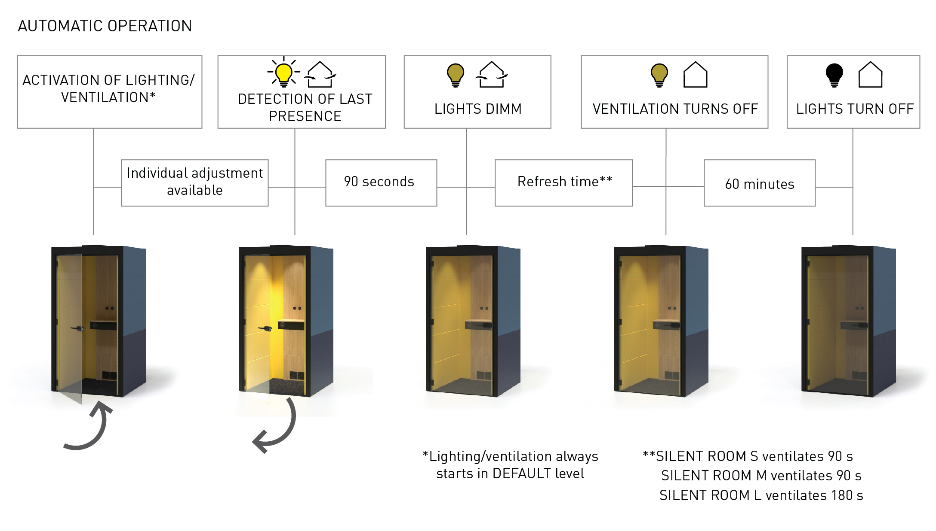
Smart energy saving
Notes:
A smart control unit selects an optimal ventilation and illumination level, and, if necessary, allows for individual adjustment. Once an employee leaves the SILENT ROOM, intense ventilation is automatically activated to prepare the room for the next user. This acoustic piece of furniture also helps with energy savings as it automatically dims the lights when no one is present in the room and even switches them off after some time.

Slide 16
DESIGN AND CUSTOMISATION

Slide 17
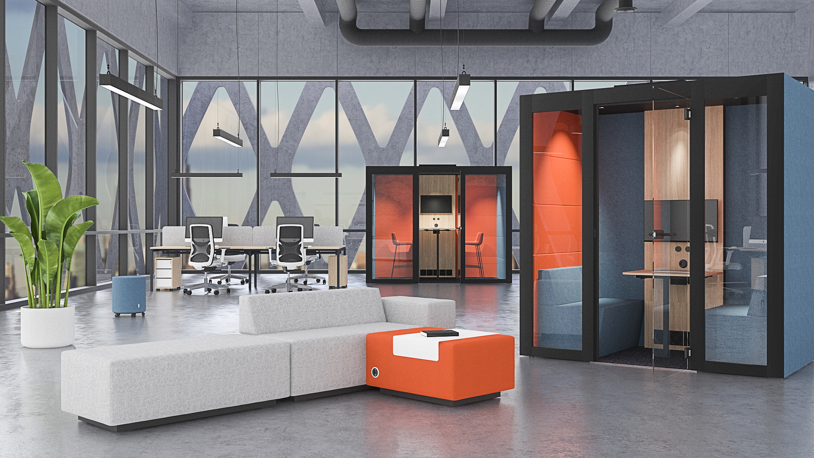
Colour combinations
Notes:
The interior and exterior finish can be selected separately. Thus the design of the SILENT ROOM can be easily customised to fit the overall office style and mood. Both melamine and upholstery can be used for the exterior finish.

Slide 18
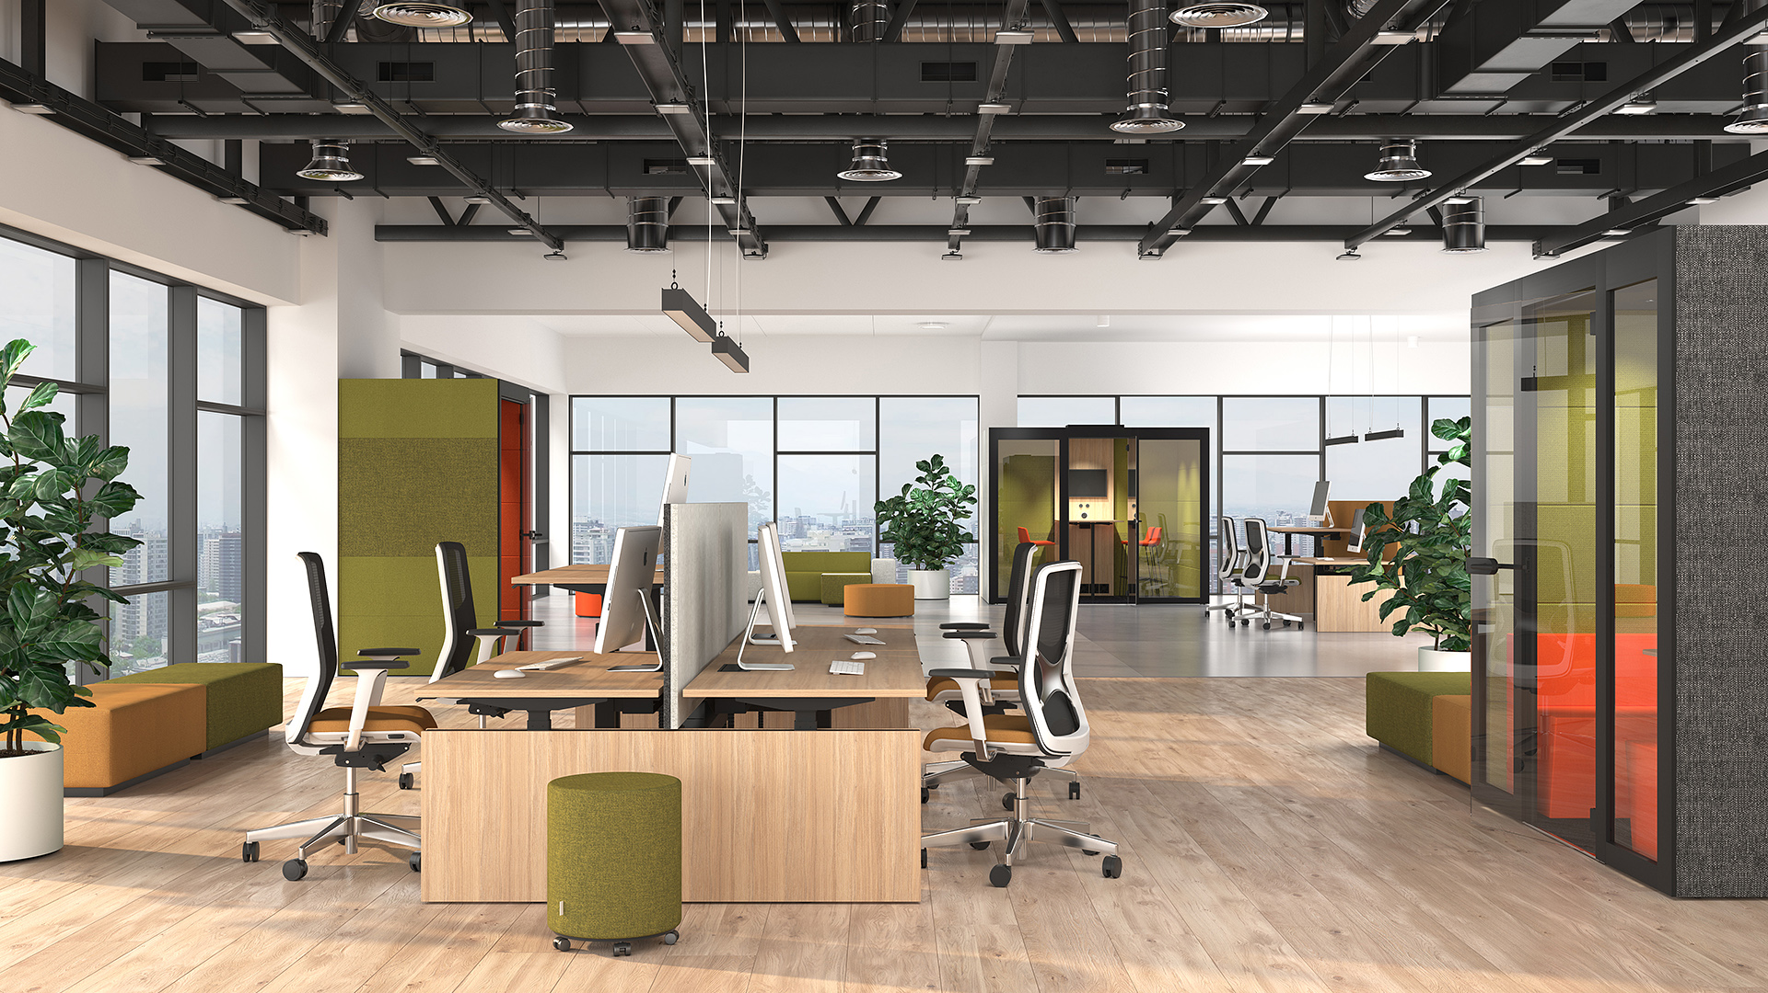
Wide range of configurations
Notes:
Due to its unique design, SILENT ROOM can be set up anywhere within the room: in the middle of the office space or near the wall, as a stand-alone acoustic unit or as an assembly of units.

Slide 19
RANGE

Slide 20
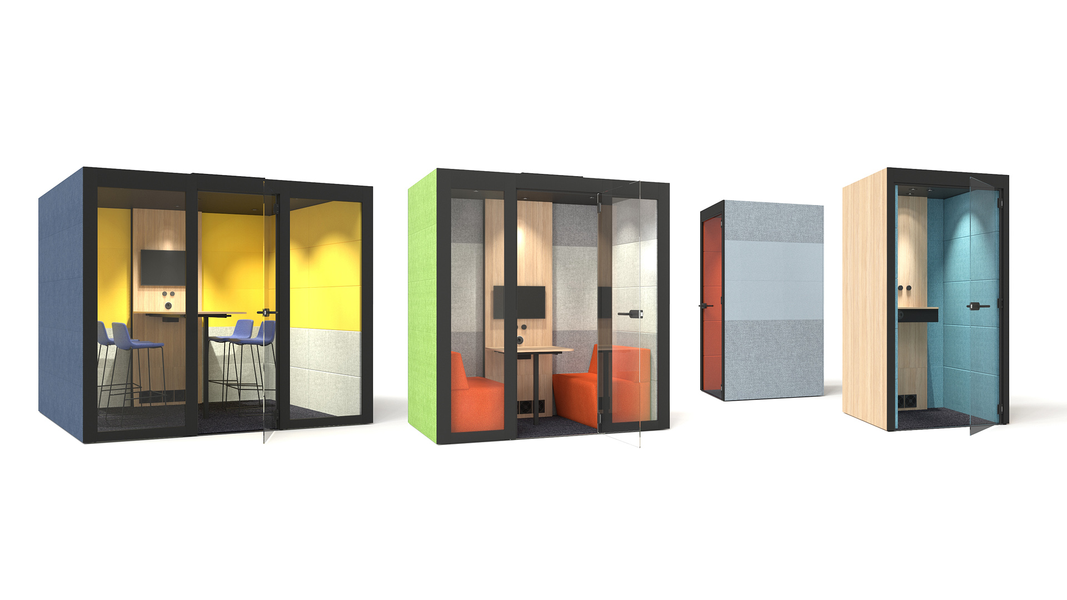
SILENT ROOM L
SILENT ROOM M
SILENT ROOM S

Slide 21
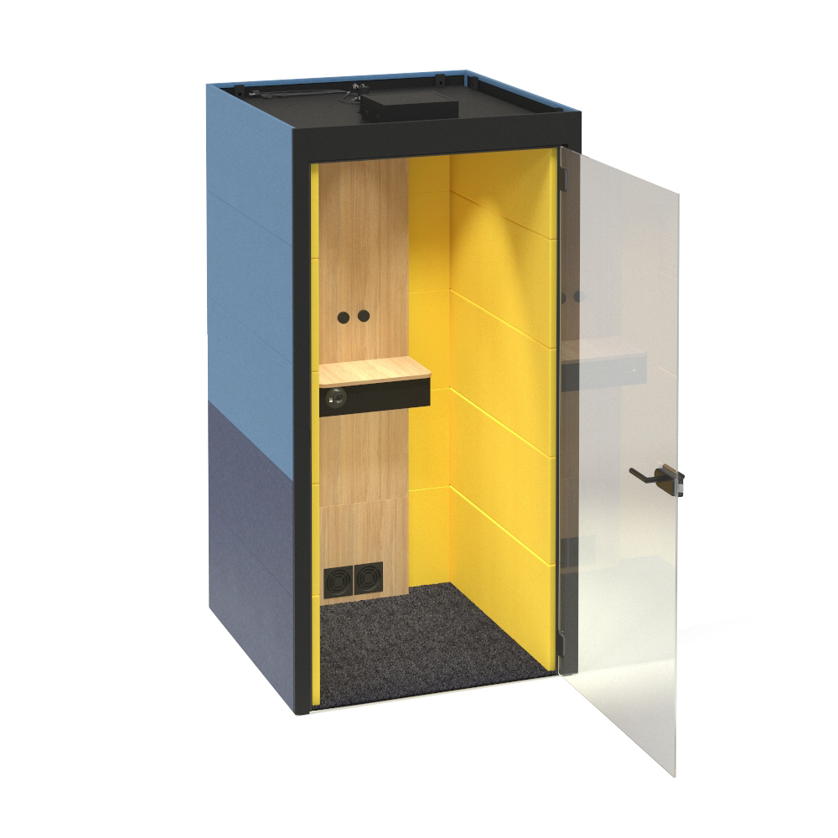
SILENT ROOM S
Notes:
For 1 person

Slide 22
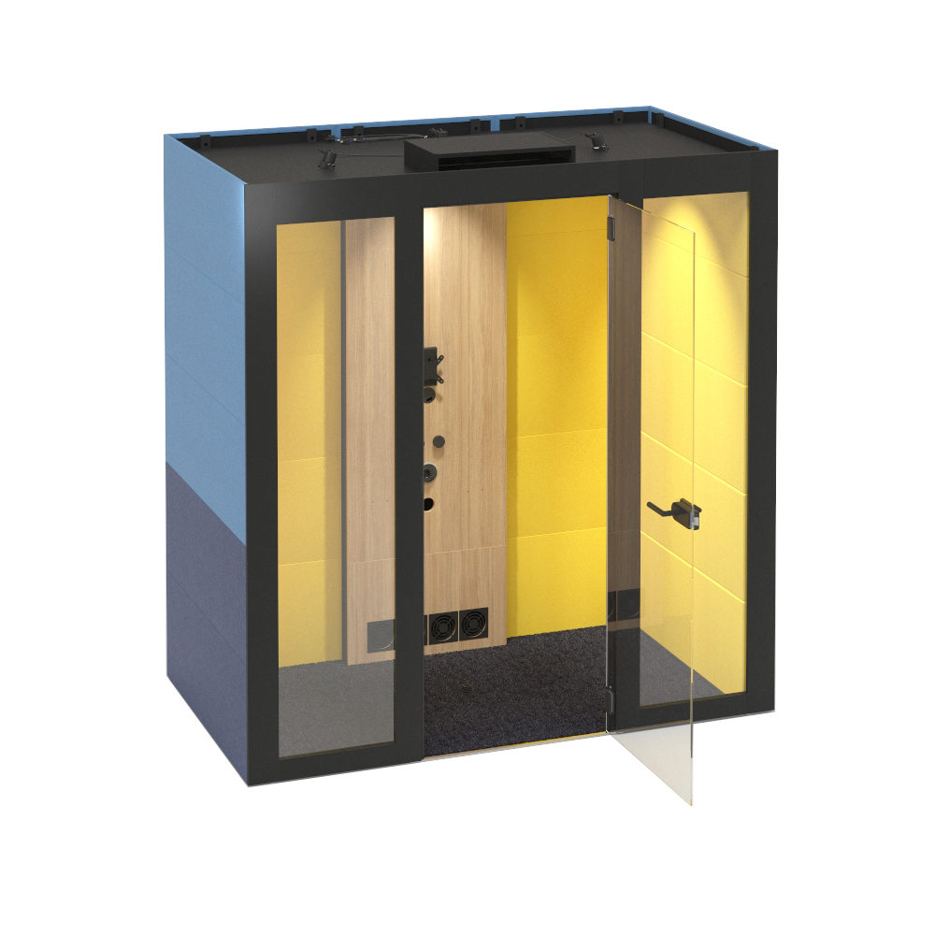
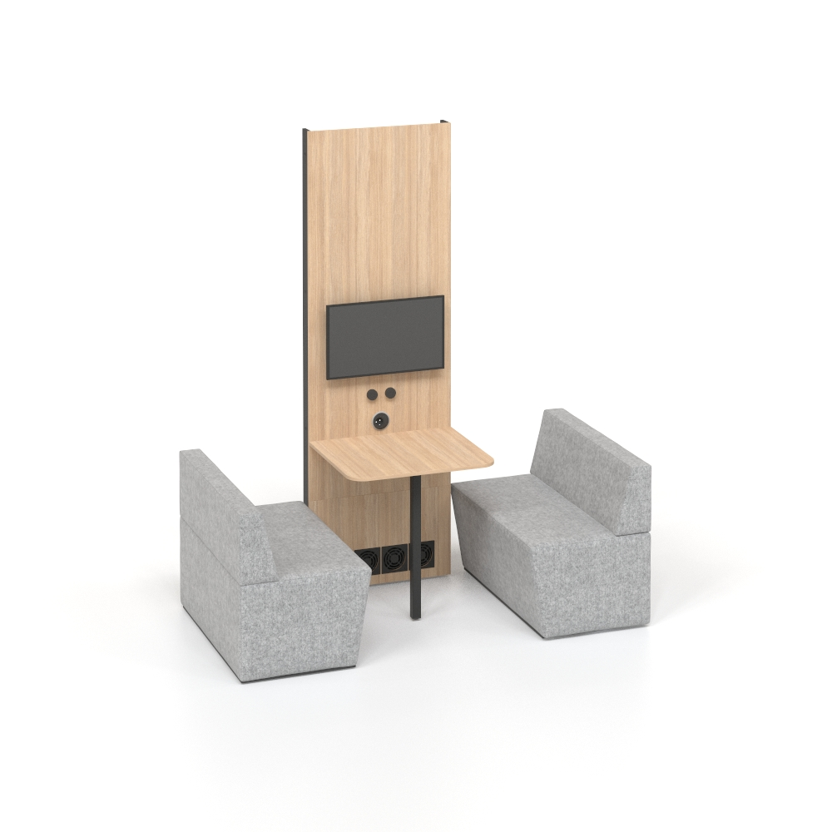
SILENT ROOM M
Notes:
For 2 persons

Slide 23
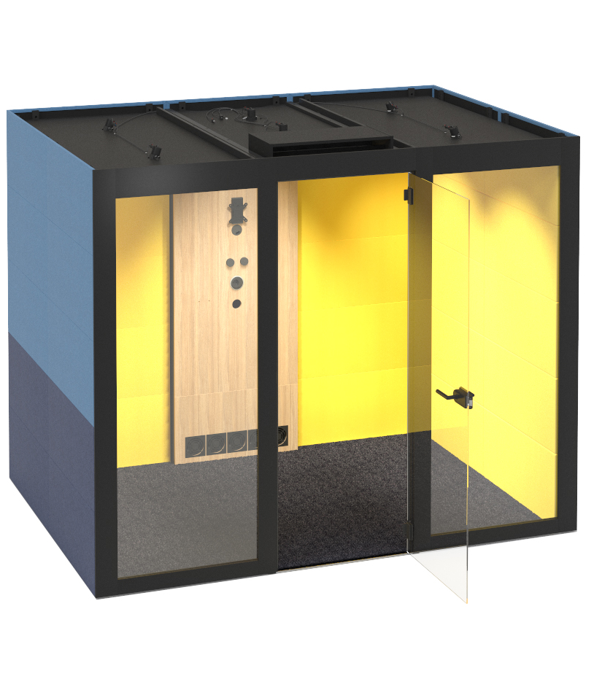
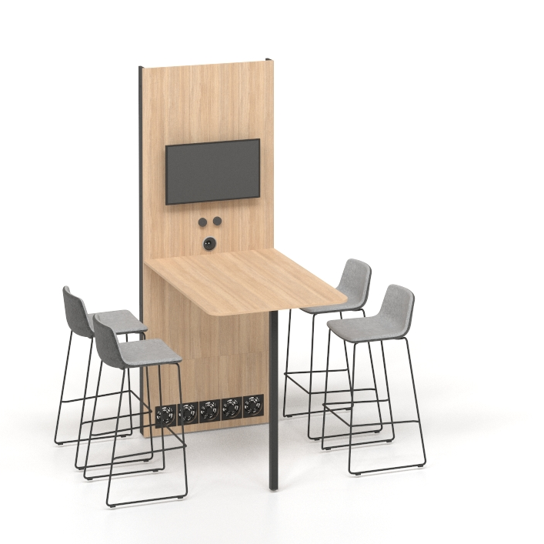
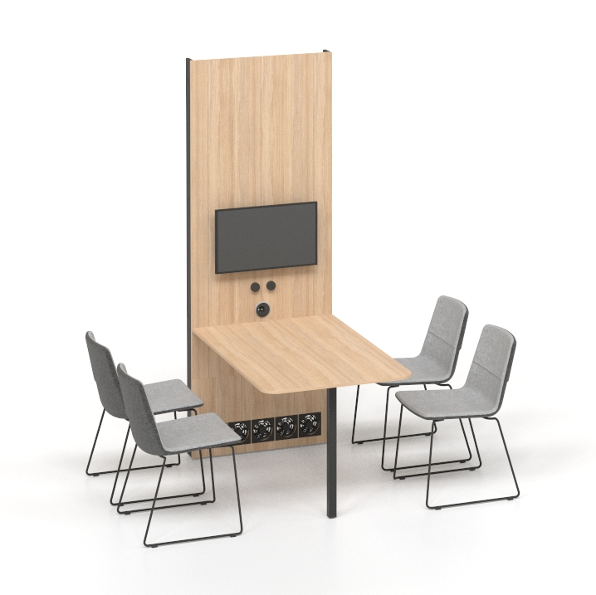
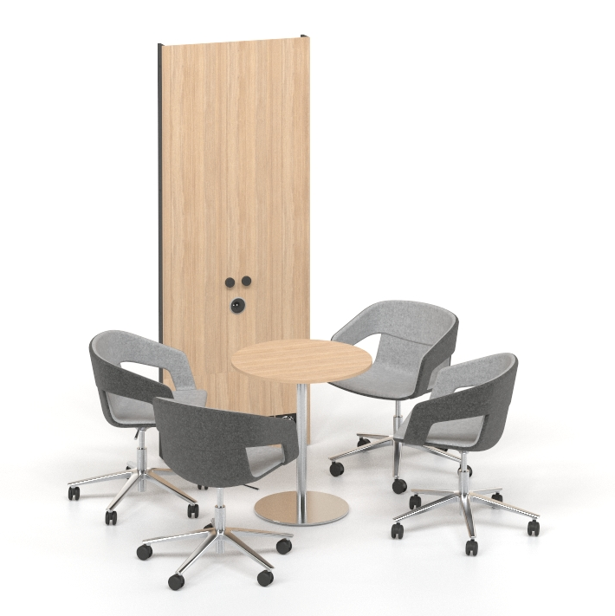
SILENT ROOM L
Notes:
For 4 persons

